Slide 1





BUILT-IN AI IN POWER PLATFORM
- MY EXPERIMENTS 🧪🔬🔍
PIOTR RUSAK
16 MAY 2024
DEVONE Hub, Gdańsk, POLAND

Slide 2


ABOUT PIOTR
Piotr Rusak
Power Platform Lead, Bossard Group
- 17+ years experience with Microsoft technologies
- 16 years experience with SharePoint
(different flavours / SharePoint close to my ❤️)
- With Power Platform since the beginning 2016
- Polish community Speaker and Mentor
#BalticSummit2023
#BalticPPCommunity

Slide 3


AGENDA
AI BUILDER
AI Builder – intro + licensing
AI Builder – what is there (AI Models vs AI Prompts)
AI Hub
AI Models – quick review and description
Document Automation – what is this ?
AI Prompts – quick description
Experiments / tips & tricks …
#BalticSummit2023
#BalticPPCommunity

Slide 4
INTRO
What is AI Builder ?
Part of Power Platform enabling usage of AI technologies such as Computer vision, OCR (Optical Character Recognition), NLP / NLU (Natural Language Processing / Natural Language Understanding), Machine/Deep learning, Generative-AI. Extracted data can be analyzed, categorized, transformed and exported to external systems in a end-to-end process.
Capability to use all integration points available in Power Platform (connectors, plugins, flows, apps…)
#BalticSummit2023
#BalticPPCommunity

Slide 5
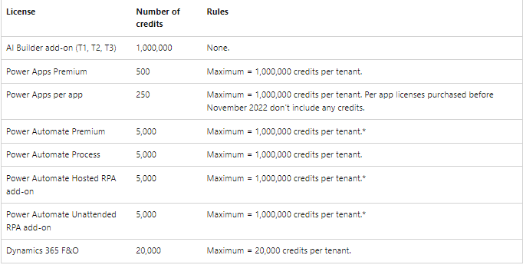
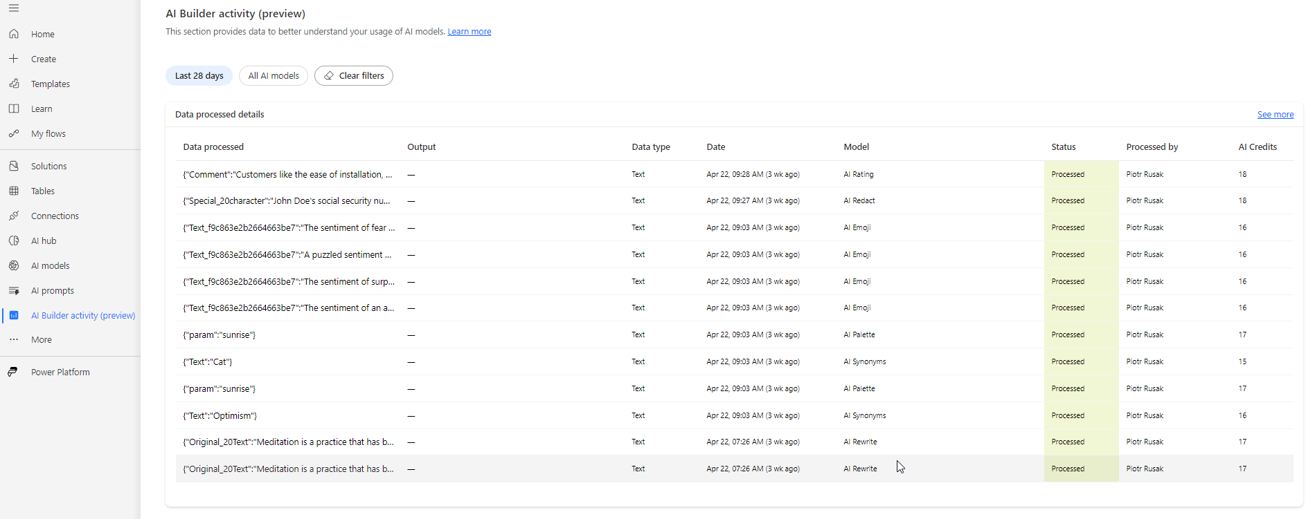
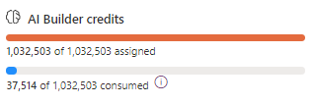
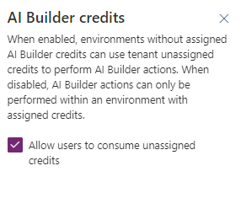
LICENSING
Access to AI Builder features within an environment requires AI Builder credits.
AI Builder credits come with some specific user licenses, but mostly from AI Builder capacity add-on.
Monitoring also crucial:
Governance is crucial:
Assign credits to environments:
Switch tenant setting (good practice – do not allow everyone to use your credits):
#BalticSummit2023
#BalticPPCommunity

Slide 6
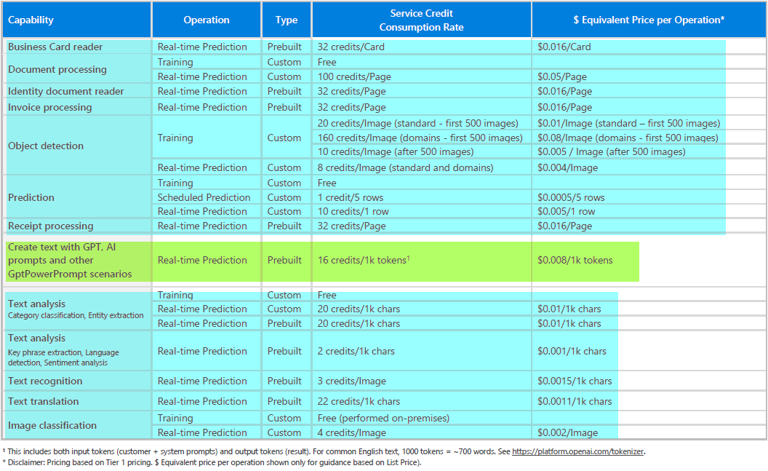
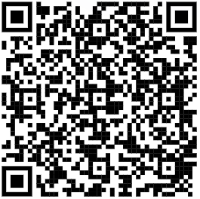
COSTS
AI MODELS
AI PROMPTS
https://powerautomate.microsoft.com/en-us/ai-builder-calculator/
#BalticSummit2023
#BalticPPCommunity

Slide 7
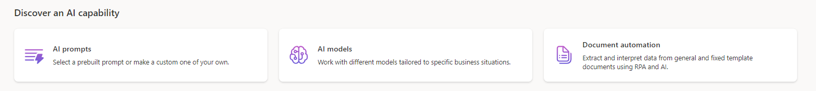



AI HUB
STARTING POINT for AI BUILDER
3 Sections available * ^{16th May 2024}
#BalticSummit2023
#BalticPPCommunity

Slide 8
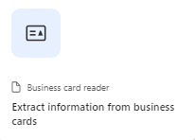
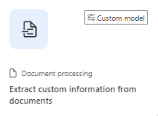
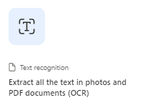
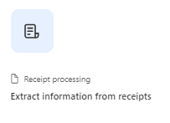
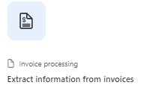
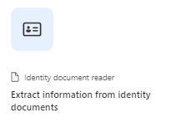
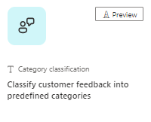
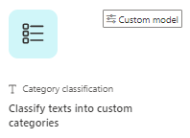
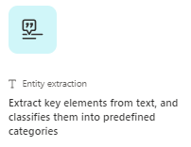
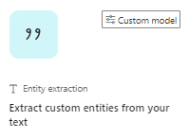
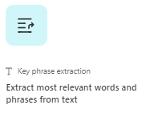
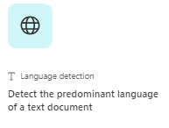
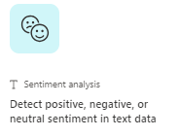
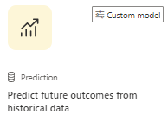
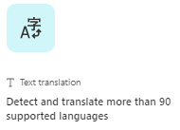
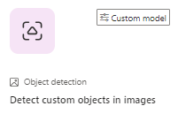
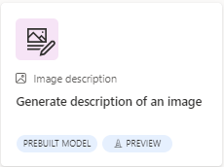
AI MODELS
Data Type | Model Type | Build Type
Documents | Business card reader | Prebuilt
Documents | Document processing | Custom
Documents | Text recognition | Prebuilt
Documents | Receipt processing | Prebuilt
Documents | Invoice processing | Prebuilt
Documents | Identity document reader | Prebuilt
Text | Category classification | Prebuilt (preview) / Custom
Text | Entity extraction | Prebuilt / Custom
Text | Key phrase extraction | Prebuilt
Text | Language detection | Prebuilt
Text | Sentiment analysis | Prebuilt
Text | Text translation | Prebuilt
Structured data | Prediction | Custom
Images | Object detection | Custom
Images | Image Description | Prebuilt
Paper documents / scans digitialization
Form Recognizer:
Purchase Order processing (PoC)
Delivery Notes processing
Invoice processing
#BalticSummit2023
#BalticPPCommunity

Slide 9
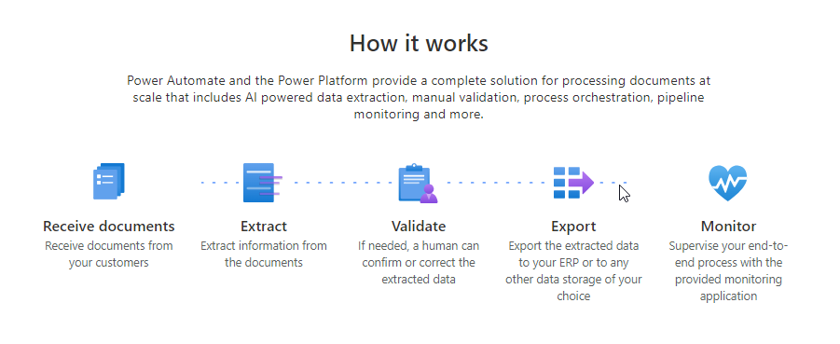
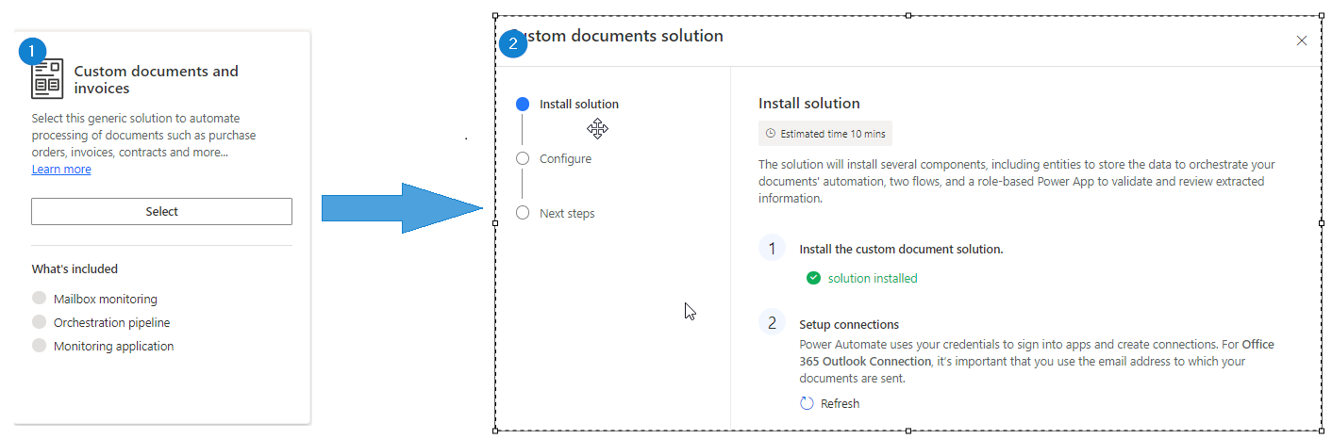
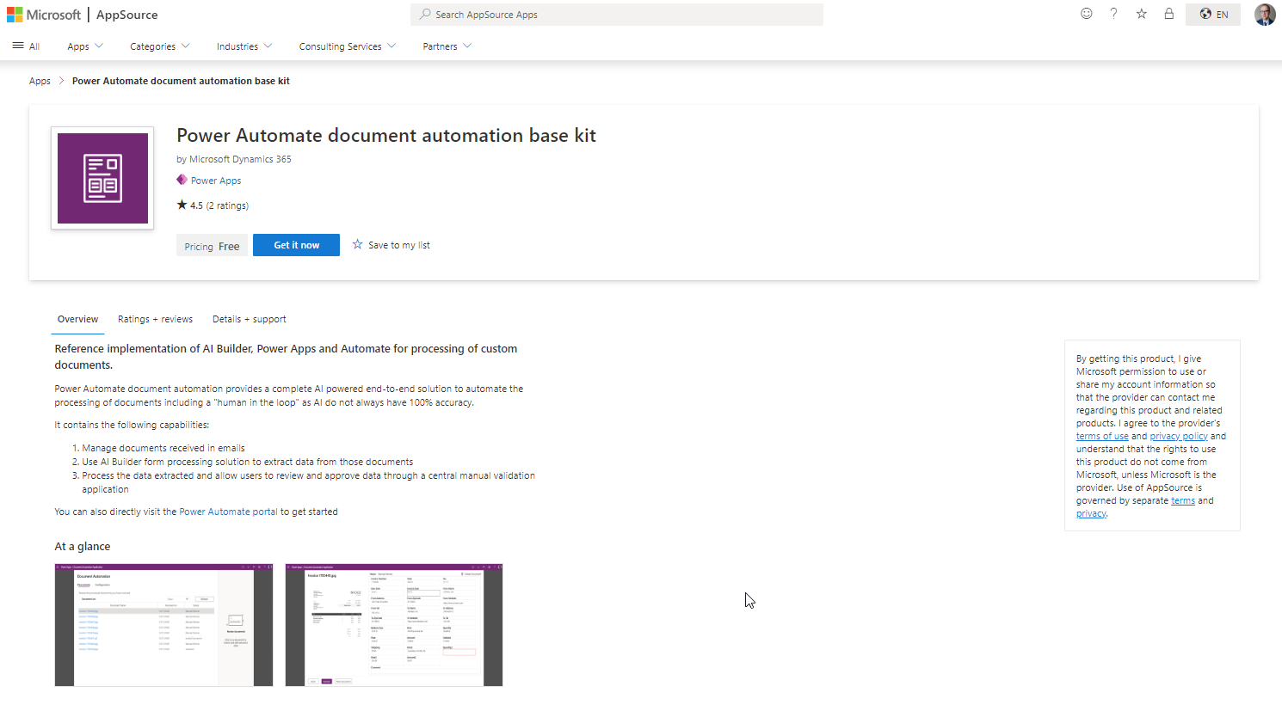
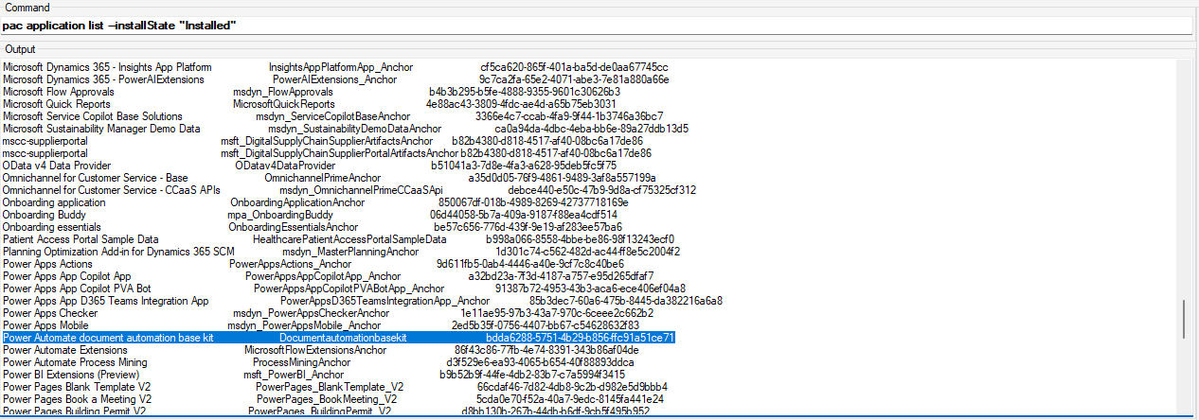
DOCUMENT AUTOMATION
MICROSOFT SAMPLE SOLUTION USING AI MODELS – DOCUMENT PROCESSING / INVOICE PROCESSING
FEW WAYS OF INSTALLING THIS APP
[3] USING PAC CLI – look for App “Power Automate document automation base kit”
pac application install
FEW WAYS OF INSTALLING THIS APP
[2] FROM APP SOURCE – look for App “Power Automate document automation base kit”
FEW WAYS OF INSTALLING THIS APP
[1] DIRECTLY FROM POWER AUTOMATE MAKER PORTAL
#BalticSummit2023
#BalticPPCommunity

Slide 10
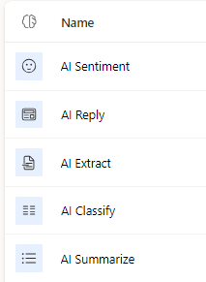
AI PROMPTS
Custom prompts give makers the freedom to instruct the GPT model to behave in a certain way or to perform a specific task.
By carefully crafting a prompt, you can generate responses that suit your specific business needs.
This transforms the GPT model into a flexible tool to accomplish various tasks.
5 Out of the box AI Prompts
AI Prompts – characteristics:
AI Prompt OOTB uses ChatGPT 3.5 (approx. 56k input characters / 16k tokens)
🆕 Possible to change GPT Model and Temperature (ChatGPT 4.0 available as preview model)
Ability to pass multiple TEXT parameters to AI Prompt (you decide)
Returns ALWAYS 2 parameters: result Text and Finish Reason parameter
Sharing with users and groups to use AI Prompts
Private for editing – you own your prompts (… but wait for DEMO)
AI Prompt is also AI Model (confusing, heh?)
Can be extended with AIPlugin / AIPluginOperation
Can be further extended to be Custom API method
🆕 Ability to enrich AI Prompt with data that comes from:
+ single standard Dataverse Table
+ specific column types only
+ up to 1000 records
+ table can be prefiltered in static or dynamic way
-
#BalticSummit2023
#BalticPPCommunity

Slide 11
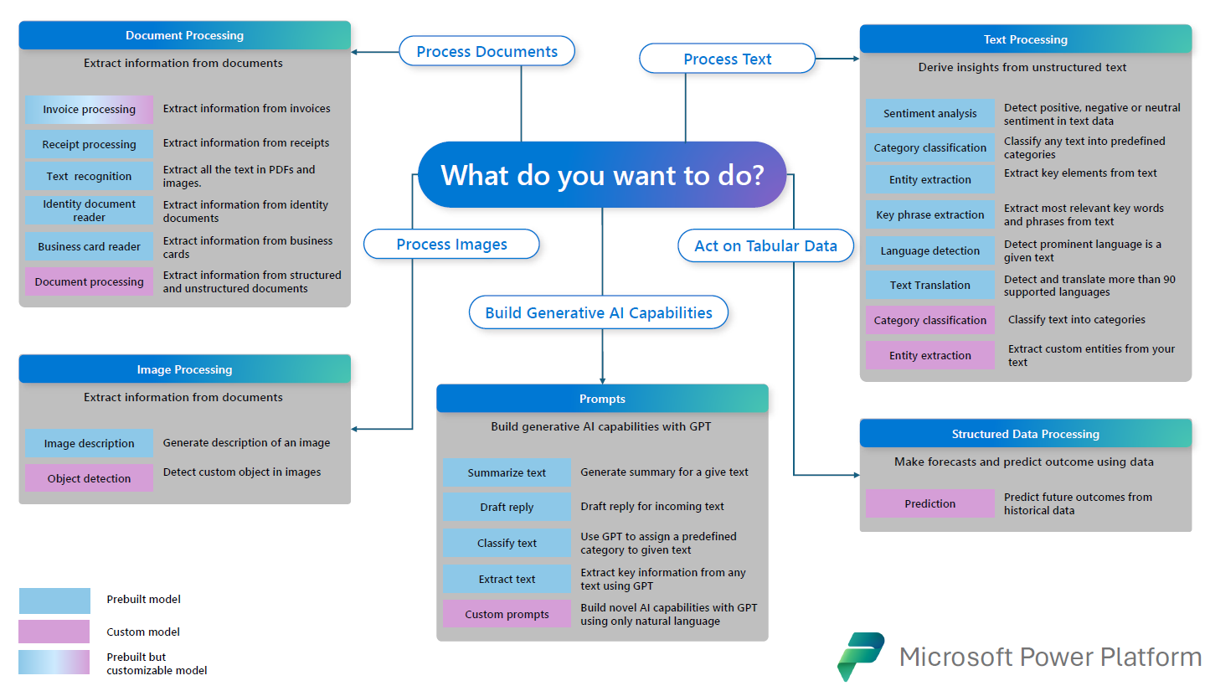
SUMMARY - IN A HUMAN READABLE WAY…
#BalticSummit2023
#BalticPPCommunity

Slide 12
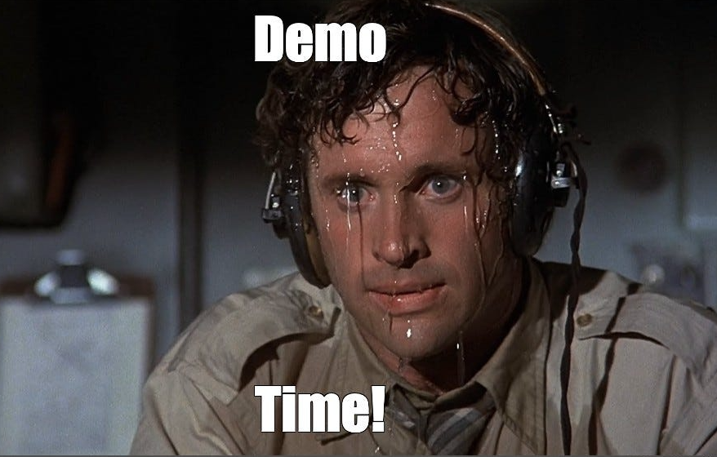
EXPERIMENTS
#BalticSummit2023
#BalticPPCommunity

